Slide 1
Spring and Summer Release Review 2020
August 5, 2020

Slide 2
High-level Release Review athenaClinical Updates athenaCollector Updates athenaCommunicator updates athenaOne updates Resources

Slide 3
athenaClinials Release Review

Slide 4
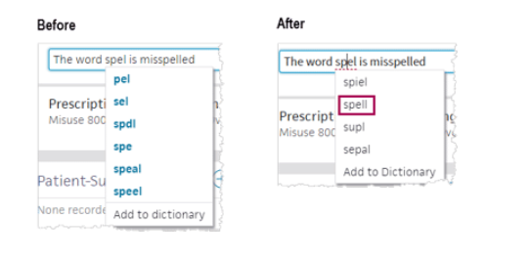
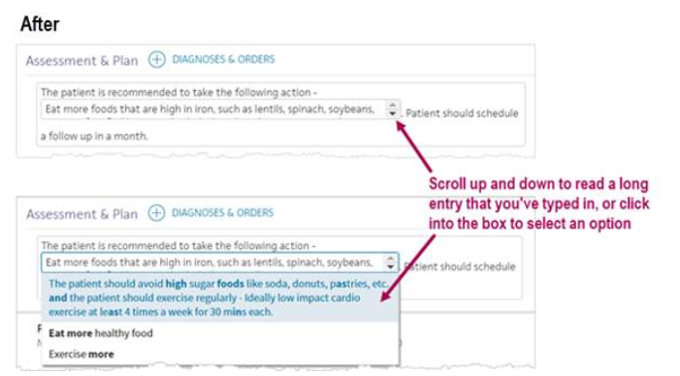

Enhancements to the Assessment and Plan Note
Key highlights include
Better suggestions for misspelled words
Ability to delete words added to your user dictionary
Improved formatting capabilities within text macros
Updated design of drop-down, date, and time boxes within text macros
Roles Impacted:

Slide 5
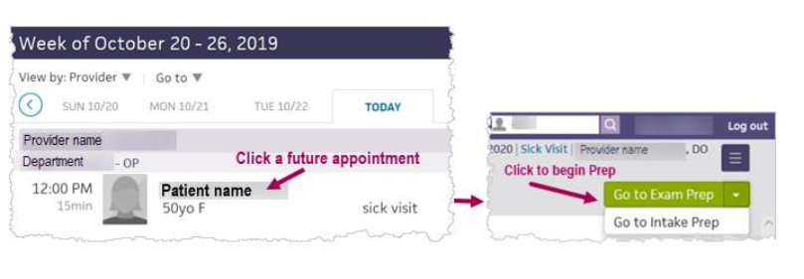

Encounter Preparation – Start Documentation Work Before Check-in!
Key highlights include
Now you can prepare for future appointments by doing the following:
Begin Encounter Preparation from the schedule on the Clinician home page as soon as an appointment is booked.
Enter notes and reminders for yourself and other clinical staff in the new Prep Notes section.
Access all steps in the Intake and Exam stages of an encounter before check-in.
See which appointments have been prepped in the schedule on the Clinician home page.
Hover on a PREPPED label in the schedule to see when the encounter was prepped and by whom.
Cannot sign orders, enter vitals and measurements, or close an encounter in Prep mode.
Roles Impacted:

Slide 6
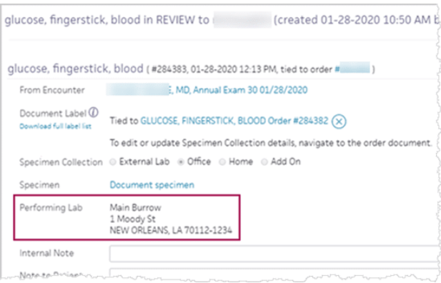
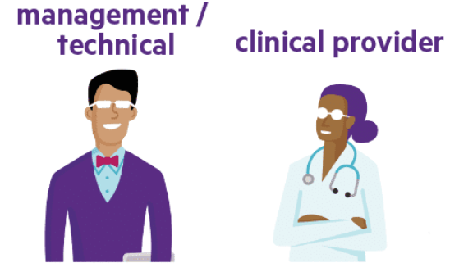
athenaNet Always shows the Performing Department Information for Point of Care Test
Key highlights include
This new feature enhancement now provides you the following information:
For point-of-care tests (POCT), athenaNet now displays the name and address of the performing, in-house department in the Performing Lab field on the results.
The information in the Performing Lab section applies to the four order office types configured on the Office Order Types page: labs, imaging, procedures, and consults.
This update ensures your practice is compliant with CLIA in athenaNet and on the printed lab result. For details, see Clinical Laboratory Improvement Amendments (CLIA).
Roles Impacted:

Slide 7
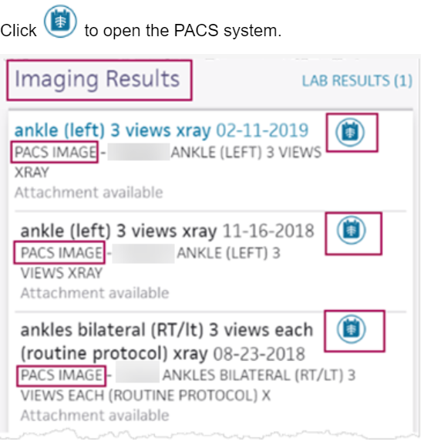
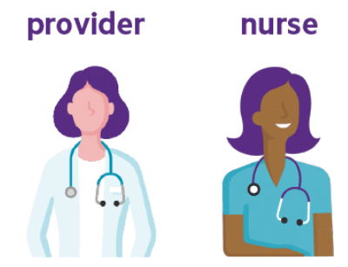
View PACS Images in Results Chart Tab
Key highlights include
Automatically shows you the results you review most often
If a PACS image is available, you see the Image icon. Click to see the image.
You must have a PACS system, which could be in an imaging facility or a hospital in your healthcare system.
Roles Impacted:

Slide 8
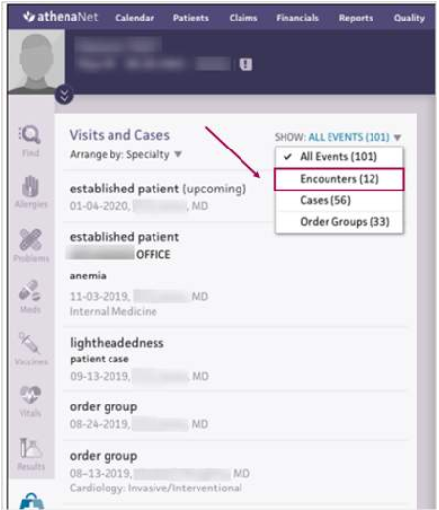

Filter the Visit Chart Tab by Encounter, Order Group, or Patient Case
Key highlights include
You now see a drop-down list at the top of the Visits and Cases chart section.
The number of each type of events appears in parentheses.
You can still sort multi-specialty practices by specialty and date.
Roles Impacted:

Slide 9
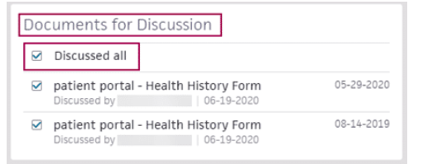
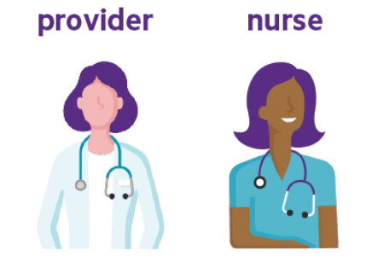
athenaNet No Longer Automatically Closes All Discussed Documents
Key highlights include
For athenaNet to automatically close a document in the Clinical Inbox, the document must be open and assigned to the rendering provider of the encounter who reviewed the document with the patient and checked the box in Documents for Discussion.
There is a new setting to change which discussed documents athenaNet closes.
Roles Impacted:

Slide 10
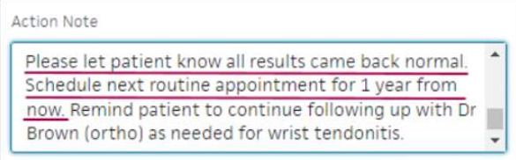
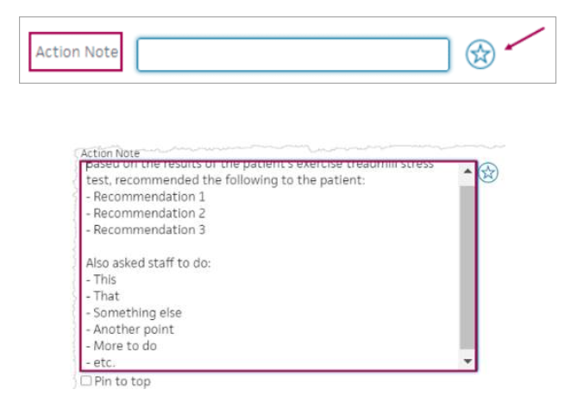

Use Text Macros and Spell Checker in Some Action Notes
Key highlights include
Text macros, sometimes referred to as accelerators, are shortcuts that you create for content you reuse.
To see if you can create and use text macros in an Action Note field, begin typing in the field. If the star icon appears on the right, you can create and use text macros in that field.
The Action Note field also expands further so you can see more of what you have already typed.
Roles Impacted:

Slide 11
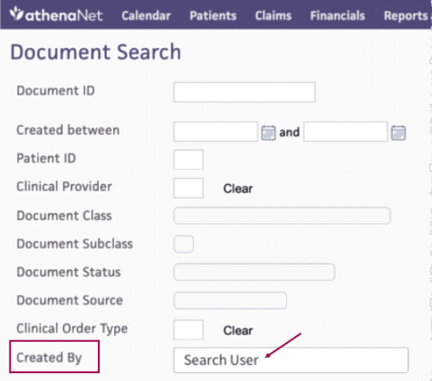

Search for a Document Created by a Specific User
Key highlights include
Use the Created By field on the Document Search page.
This procedure locates documents created by athenaNet users with active user accounts.
For the new Created By field to load properly and show detailed user information, such as specialty, the athena CDN Datacenter must have a Connectivity Status of OK.
Roles Impacted:

Slide 12
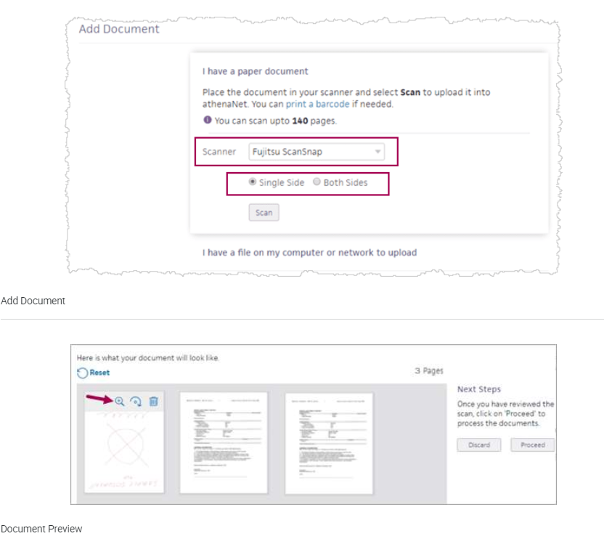
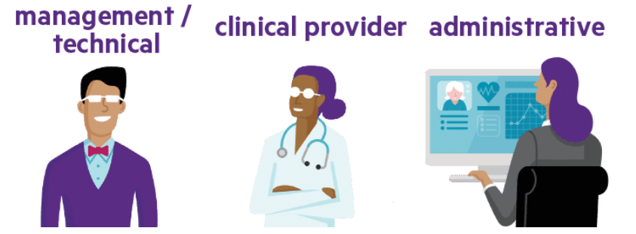
Scan Documents Directly into Patient Charts
Key highlights include
You can use this feature with any TWAIN-supported desktop scanner or Fujitsu ScanSnap scanner.
If your scanner supports duplex scanning, you can scan two-sided documents.
You can scan documents with barcodes, which route to the associated patient charts.
You can scan up to 140 pages.
After scanning paper documents into athenaNet, you can view and modify scanned documents.
Roles Impacted:

Slide 13
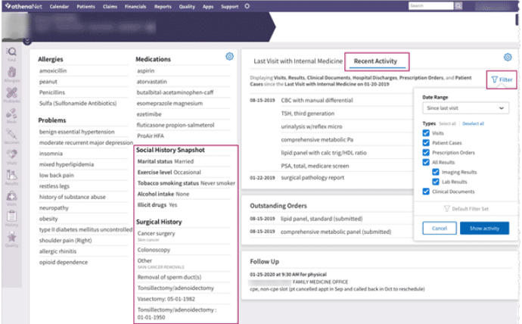

Patient Briefing Enhancements
Key highlights include
Show more patient history information.
Choose to see Recent Activity or Last Visit on the top right of the briefing upon opening the chart.
Filter the Recent Activity section.
Roles Impacted:

Slide 14
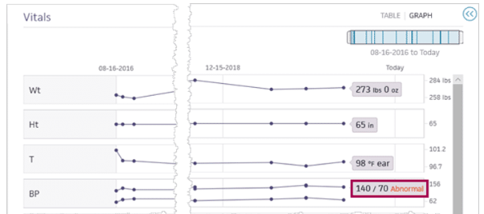

Alert Providers of Abnormal Visits
Key highlights include
New alerts prevent data entry errors and help draw attention to a patient’s out-of-range vitals readings, which may be especially helpful to providers on busy days.
Affects only some vitals: Blood Pressure, Temperature, Pulse/Heart Rate, Respiration Rate, and Oxygen Saturation
Displays an Abnormal flag in the Intake and Exam stages of the encounter, on the patient briefing, and in the patient chart
Won't allow you to enter the wrong type of data or to save values that are physiologically impossible
Requires setup to see Abnormal flags for out-of-range vitals
Roles Impacted:

Slide 15
athenaCollector Release Review

Slide 16
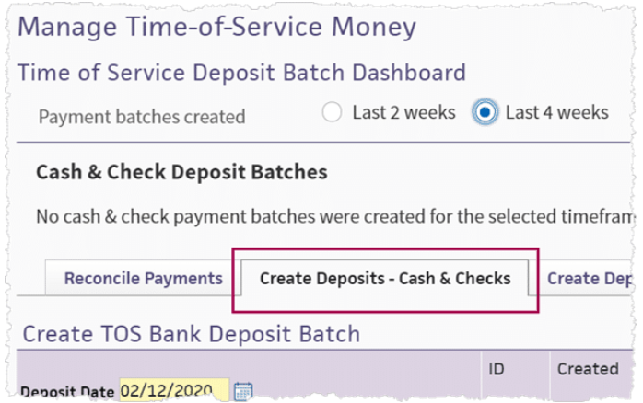
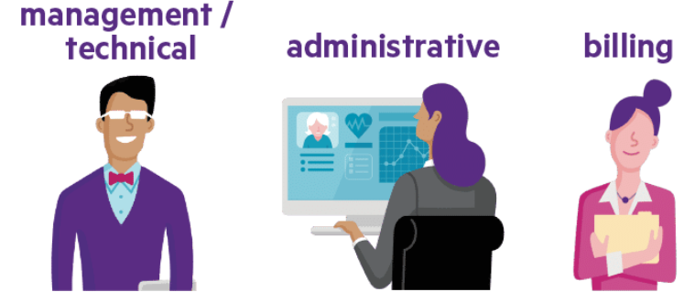
Time of Service Money Page Enhancements
Key highlights include
Updated tabs on the Manage Time-of-Service Money page.
New tabs include Create Deposits - Cash & Checks and Create Deposits - Credit Cards.
Create Deposits - Credit Cards is a new workflow for creating deposits for credit card payments taken outside the athenaNet automated process.
Workflow for creating cash and check deposits has not changed.
Advanced view of payment batch filters now the default view.
Payment batches that contain only non-cash adjustment transactions removed.
Roles Impacted:

Slide 17
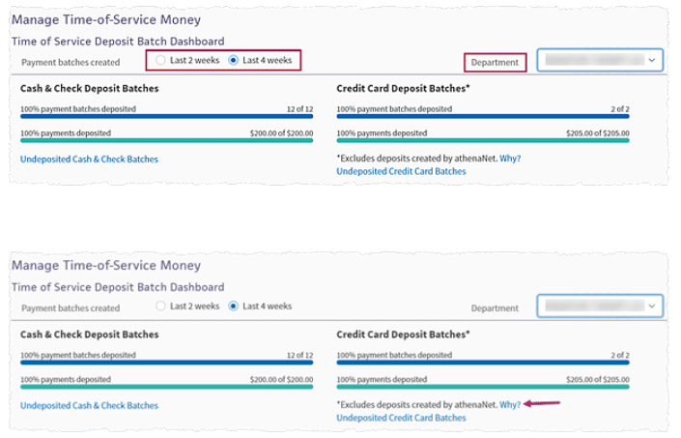

Time of Service Deposit Batch Dashboard
Key highlights include
View number of cash and check TOS payment batches placed in deposit batches and the amount of money in those batches.
View number of credit card TOS payment batches placed in deposit batches and the amount of money in those batches.
Use filters to display payment batches deposited for the last two or four weeks for selected departments.
Roles Impacted:

Slide 18
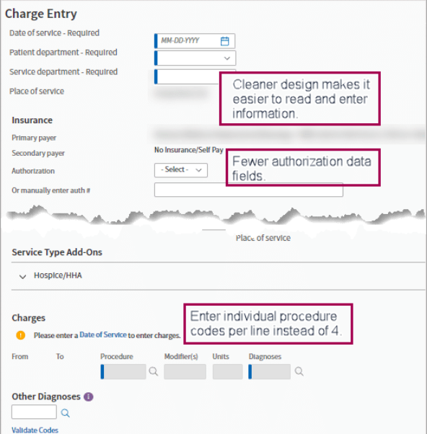

Enhanced Charge Entry Page
Key highlights include
To streamline and accelerate the charge entry workflow, you now enter a single procedure code per line (instead of four) and you can copy diagnosis codes to subsequent charges.
New Claim Preview page provides a snapshot view of claim information while athenaNet creates the claim and runs its rules engine.
This change is an important first step toward improving the billing experience in athenaNet, which will include reducing the manual work required to create and edit claims.
Roles Impacted:

Slide 19
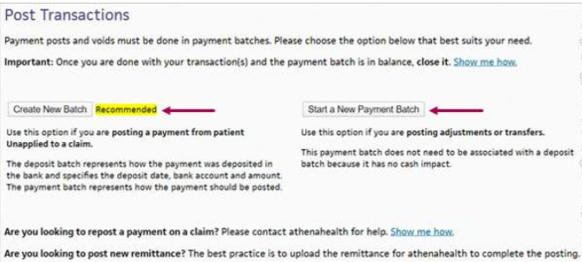
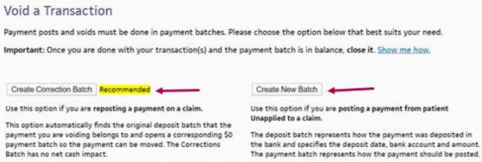

athenaNet closes Zero Dollar Manual Payment Batches
Key highlights include
Manual payment batches are now easier to manage as athenaNet now runs a nightly script that automatically closes specific payment batches.
athenaNet runs a nightly script that automatically closes any manual payment batches that you open with a $0 target if those batches are in balance.
athenaNet closes only the manual payment batches that you open yourself.
The Payment Posting Note and Transaction Void pages now offer a recommendation about the type of batch to open.
We rename the Payment Posting Note page to the Post Transactions page.
We rename the Transaction Void page to the Void a Transaction page.
Roles Impacted:

Slide 20
athenaCommunicator Release Review

Slide 21
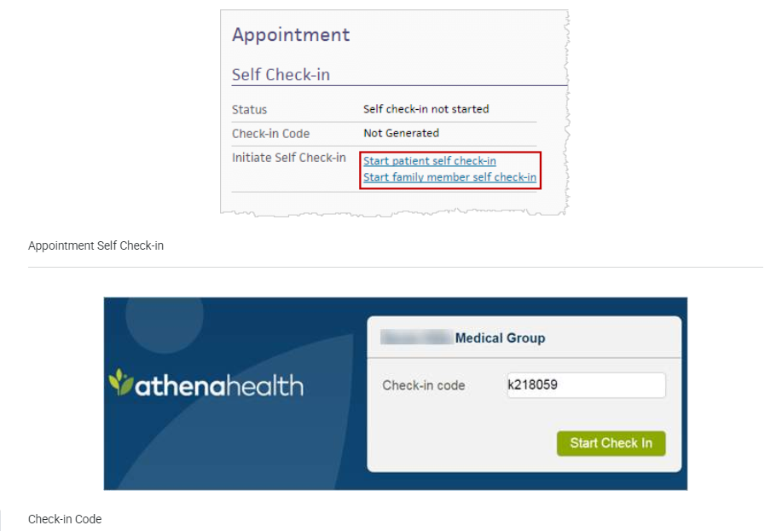
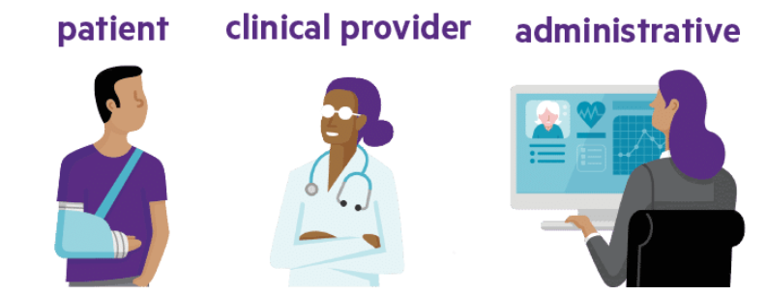
In-Office Self Check-in Workflow
Key highlights include
Previously, patients could only complete online self check-in prior to coming into the office from a ReminderCall email or the Patient Portal. Now they can complete self check-in in the office which provides them with another opportunity to update their health and other information prior to speaking with a clinician. This feature helps:
Reduce work for clinical staff.
Save money dealing with less paper.
Spend more time interacting with patients.
Use an office device or the patient’s smartphone.
Roles Impacted:

Slide 22
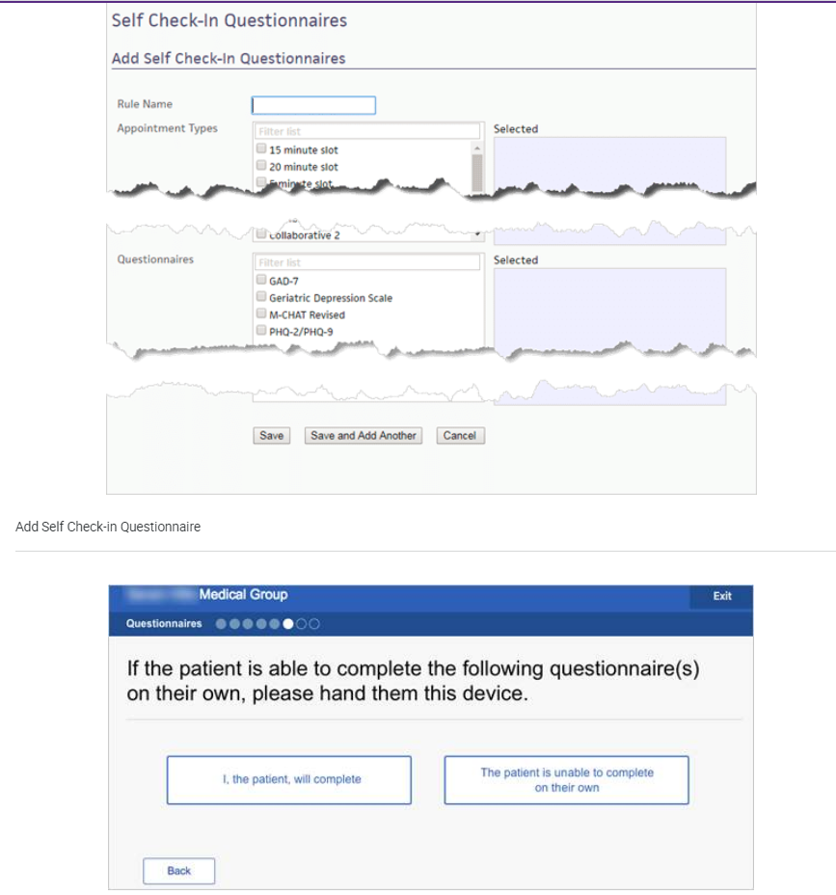

Screening Questionnaires Now Available during In-Office Self Check-in
Key highlights include
Reduce work for clinical staff.
Spend more time interacting with patients.
Choose which screening questionnaires appear for each appointment type.
Use an office device or the patient’s smartphone.
Review, modify, add notes, and rescore during encounter as necessary.
Not available for out-of-office self check-in at this time.
Roles Impacted:

Slide 23
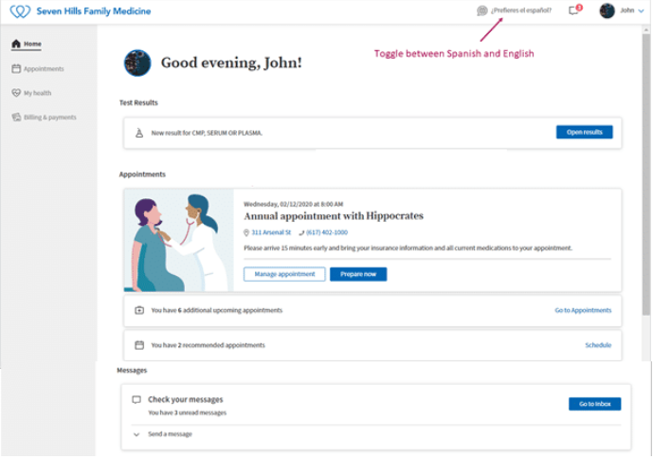

Engage Patients with the Refreshed patient Portal Home Page and New Navigation
Key highlights include
Updated home page – The usable space on the page is wider and serves up the most relevant and current information the patient may need to know without having to drill-down or click around to find it.
Streamlined navigation – The left-hand navigation pane contains only the most frequently accessed links with sub-navigation links now available as tabs across the main body of the page instead.
Consolidated patient profile – The header now contains an image of the patient (My Profile) that expands to show all patient-related settings in one handy location.
Roles Impacted:

Slide 24
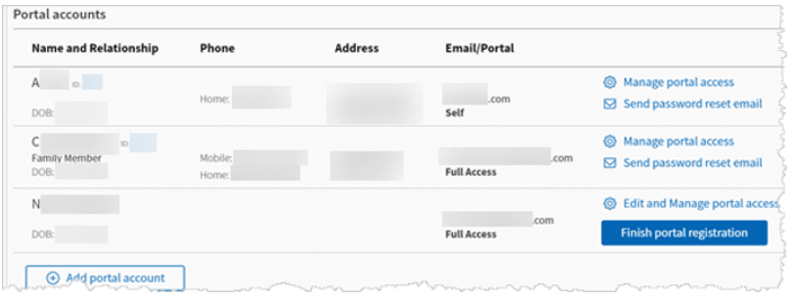
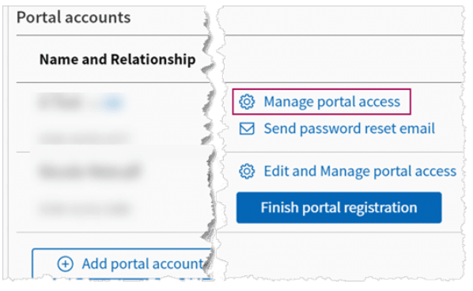

View More Detailed Patient Portal Contact Information
Key highlights include
View a new Portal Accounts section directly under the Contact section on the Quickview page.
See contact information in a way that clearly identifies who it belongs to.
View more detailed contact information for the patient's family members.
Roles Impacted:

Slide 25
athenaOne Release Review

Slide 26
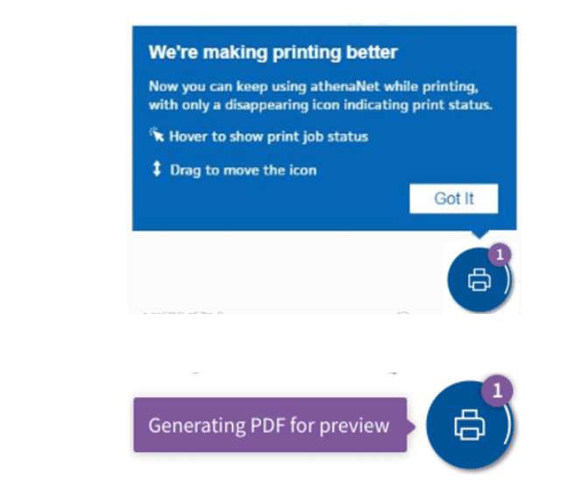
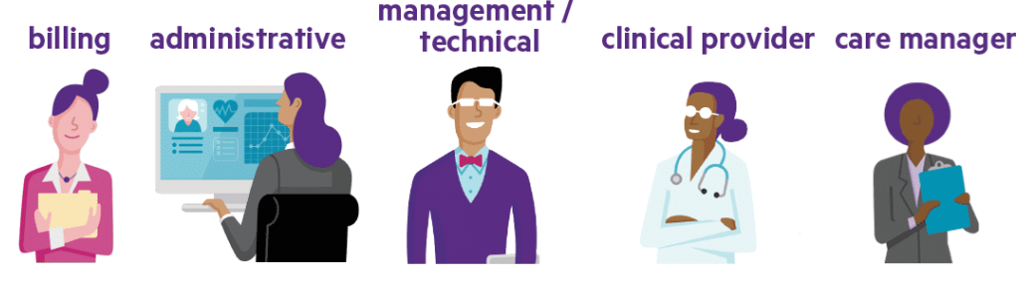
Improved athenaNet Print Experience
Key highlights include
See a print status icon that appears in the right corner of the window.
Hover your cursor over the print status icon to view the status of your print job.
Continue working as print jobs run without disruption to your athenaNet workflows.
Roles Impacted:

Slide 27
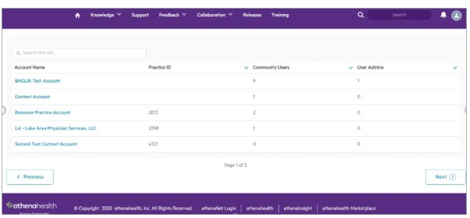

Manage Support User Permissions on the Success Community
Key highlights include
Streamlines the process of granting users support and contributor permission to the Success Community.
New Community User Admin designation lets you update the support and contributor permissions.
Manage permissions on the new User Admin page and Account Admin page on the Success Community.
If you’re designated a Community User Admin for multiple athenaNet organizations, you can easily apply the same permissions to a user across multiple organizations.
Roles Impacted:

Slide 28

View Resolved and Closed Cases for Past Two Years on Success Community
Key highlights include
Roles Impacted:
View support cases for two years from the date they’re resolved or closed.
Request access to critical support cases that have been resolved or closed longer than two years ago or request to exclude new support cases from the two-year limit.
The two-year limit does not apply to cases with a known issue status.

Slide 29
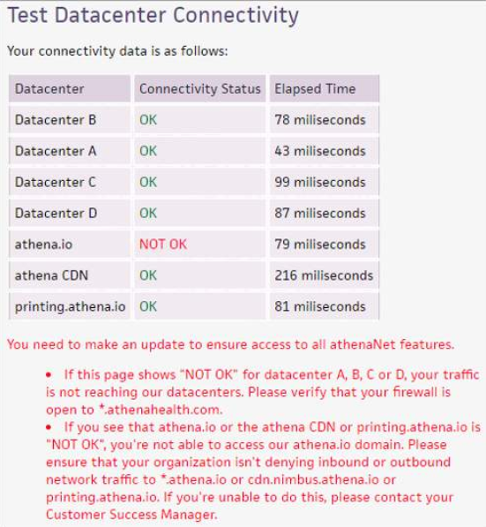

Transition to Domain-Based Network Filtering to use athenaNet and athenahealth services
Key highlights include
Per our technical requirements, full use of athenaNet and athenahealth services requires connectivity to:
  *.athena.io
  *.athenahealth.com
  *.epocrates.com
  secure.athenahealthpayment.com
With our Fall 2020 Release in November, we’ll no longer support IP-based filtering for access to athenaNet and athenahealth services. Connectivity to athena.io will be required. If you do not allow access to these entire domains, you will not be able to access athenaNet.
You can check to see if your organization permits access to *.athena.io on the Connectivity Test Page.
Roles Impacted:

Slide 30
athenaOne Features Postponed

Slide 31
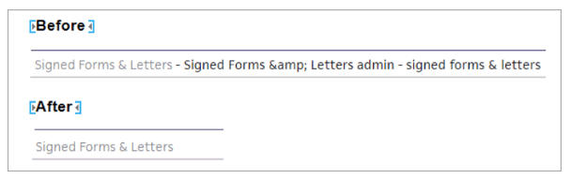
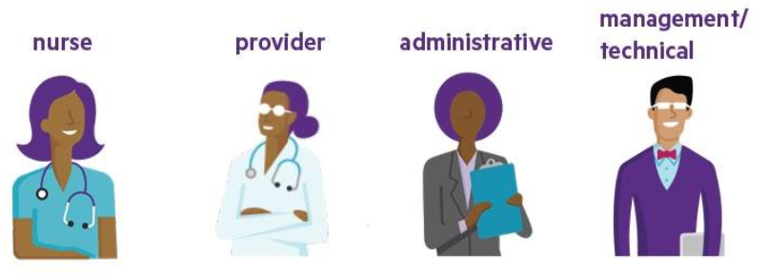
Clinical Inbox Performance & Task Description Improvements
(Postponed)
Key highlights include
Task lists in the Clinical Inbox and List View load more quickly
Shorter and clearer task descriptions for improved readability
New architecture lays the foundation for future feature enhancements
Roles Impacted:

Slide 32
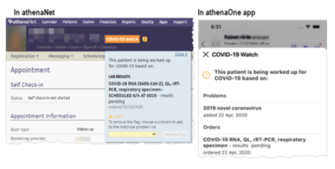
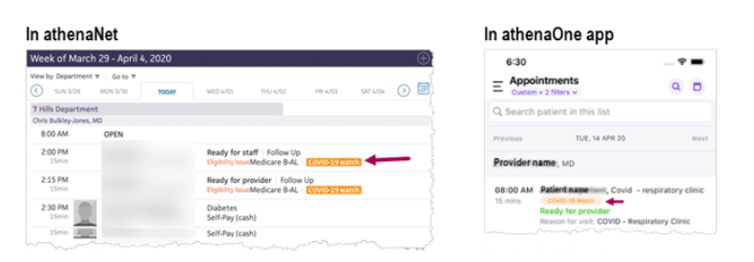
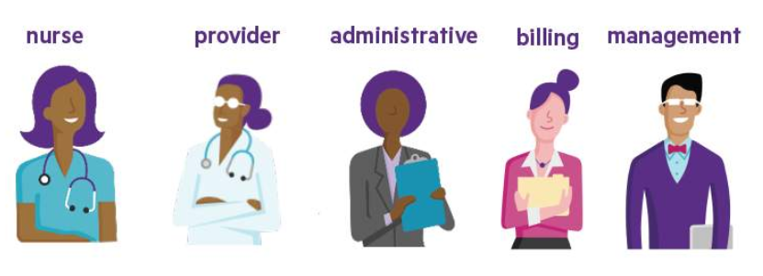
Covid-19 Watch Flags in the Schedule (Postponed)
Key highlights include
A COVID-19 watch flag appears when a patient is suspected or confirmed to have COVID-19.
The flag appears if you order a COVID-19 test, receive or upload a result for a COVID-19 test, add a COVID-19 related SNOMED problem to the Problems list, or add a COVID-19 related diagnosis.
Both clinicians and non-clinicians can see the flag in the schedule.
To view more details, hover over or tap the flag in the patient banner.
Roles Impacted:

Slide 33
Release Center Resource
https://success.athenahealth.com/s/summer-2020-release

